Slide 1
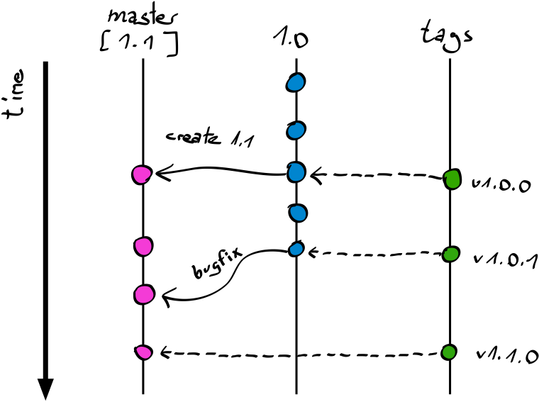
Configuration Management Practice in an Agile Team
By Kane, Ren

Slide 2
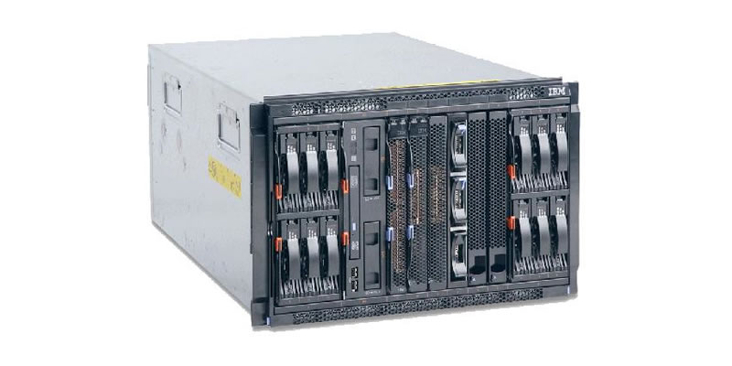
Background
Product: An Hardware + software box solution for network management, customers are mobile network carrier in world wide.
Hardware: A box with 6-10 blade servers.
Software: Based on RedHat linux
Team: ~ 140 Developers, 100+ Testers.
In 3 different site in different time zone.
Scrum model.
Languages: C (backend), Java (Web GUI).
Release frequency:
Internal Milestone release to QA per week.
Release to customer every few months.
Special situation:
Customers are caution, they prefer patch the old releases instead of try new releases, so there are always some maintain branches.

Slide 3
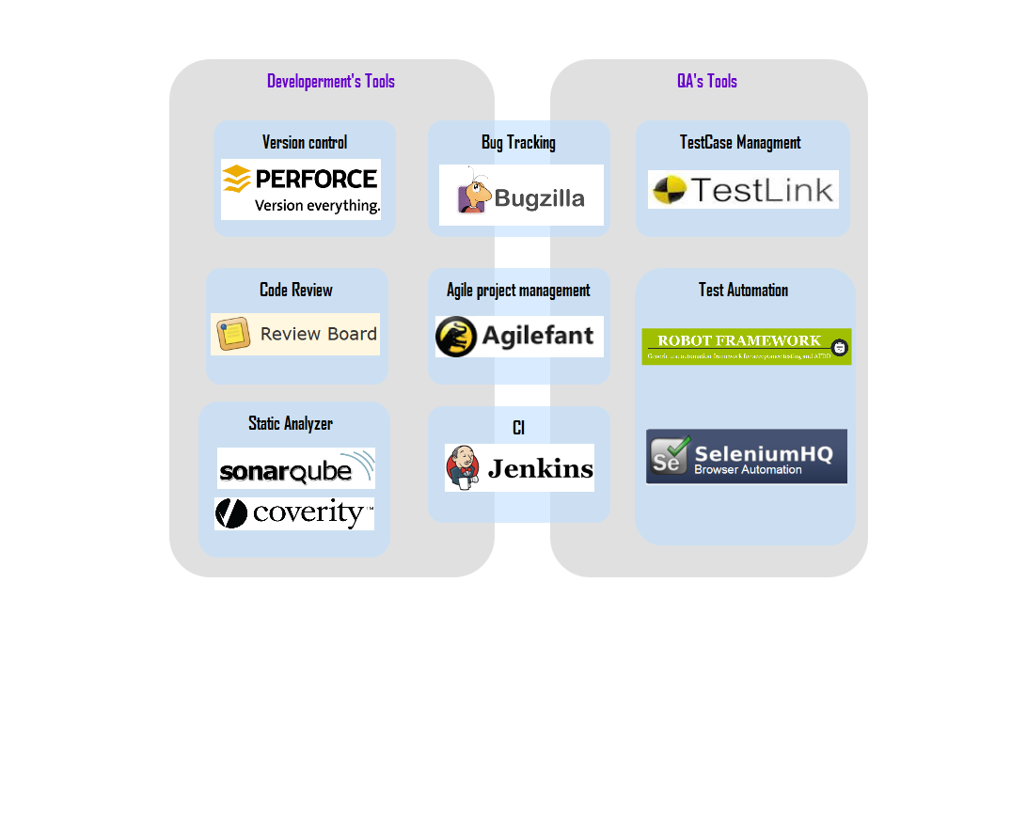
Tool Chain
Cost sensitive, Prefer Open source tools.

Slide 4
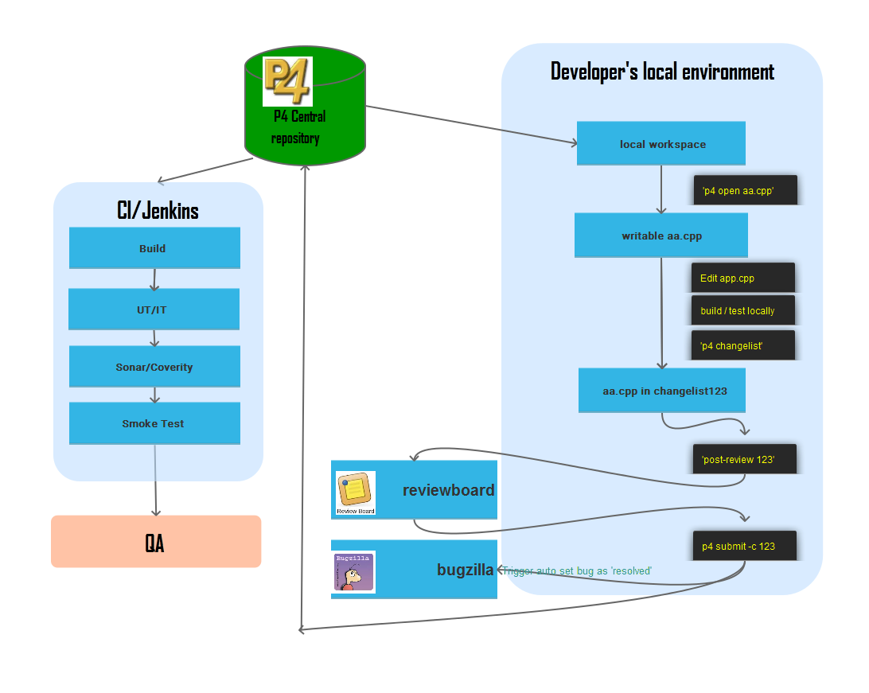
Workflow: Change Management

Slide 5
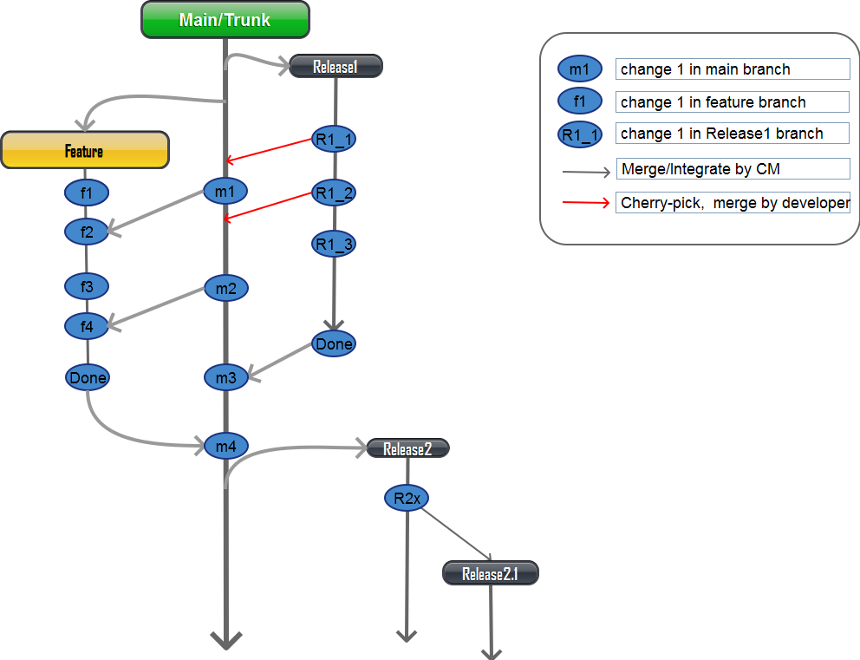
Branches

Slide 6

Identification: Version And Milestone
Unique Changelist ID by P4
PreAlpha1..x,
Alpha1..X
Beta1..X
RC1..X
LA, GA,MA

Slide 7
Uniform Build Environment
Metal work/build server all in RHEL6.4
Tools: like IDE, P4
/home/tools
/home/tools/public
Sandbox: To simulate RHEL62, RHEL71 environment for build.
/home/sandbox/rhel62
/home/sandbox/rhel71
If need build in RHEL6.2, RHEL7.1, Use chroot to switch different OS Version environment
chroot /home/sandbox/rhel71
make
Third-party: libs from 3rd
/home/thirdparty
Environment change control:
All the changes in Thirdparty, tools, sandbox, should be committed to P4 at first, and need review by ReviewBoard just like other code changes.
/home/tools, /home/thirdparty, /home/sandbox are own by user ‘tools’, all other uses can’t write it, use Jenkins to auto sync changes from P4 automatically when new changes found.

Slide 8
Release Procedure
PICK: Check If Team had committed all the promised changes, pick the right one for release.
Check: Check build and Smoke test result from CI, if pass, Send the build info and smoke test report to tester, then tester could carry on with other testing.
Prepare: Collect test report, release notes.
Meeting:
Schedule and release meeting.
go through the feature/bugfixs planed for this release.
Review the test reports and release notes.
Dev manager and QA manager need give green light if they think everything ready for release.
Promote: Tag software, upload binaries, make release announcement officially, update release schedule.
Close Branch(Optional)
If branch is finished, lock the branch, and if in release branch, try merge back to main to avoid any regression issues.

Slide 9

Possible improvement ?
Move part of CI before commit, like build, UT, Sonar.
Use Docker to make uniform build environment.

Slide 10

General strategy for CM
Keep software’s integrity and traceability throughout the software lifecycle.
Work with Team, find a balance between strict change control and quick delivery according to project’s situation.
Automation, Automation, less manually work in CM’s scope make integration and delivery quick and precise.

Slide 11

Personal advantage
Worked at both Big and Small teams, more experience in practice.
Good knowledge of continues integration.
Strong Script skills helps on automation, Continues Integration and continues delivery.

Slide 12


Slide 13
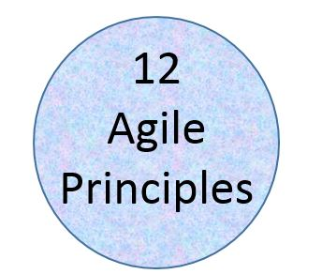
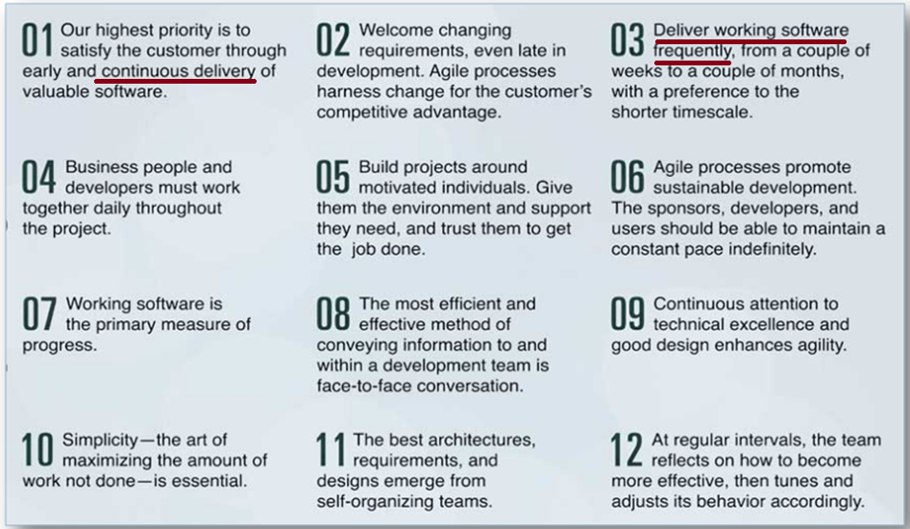

Slide 14
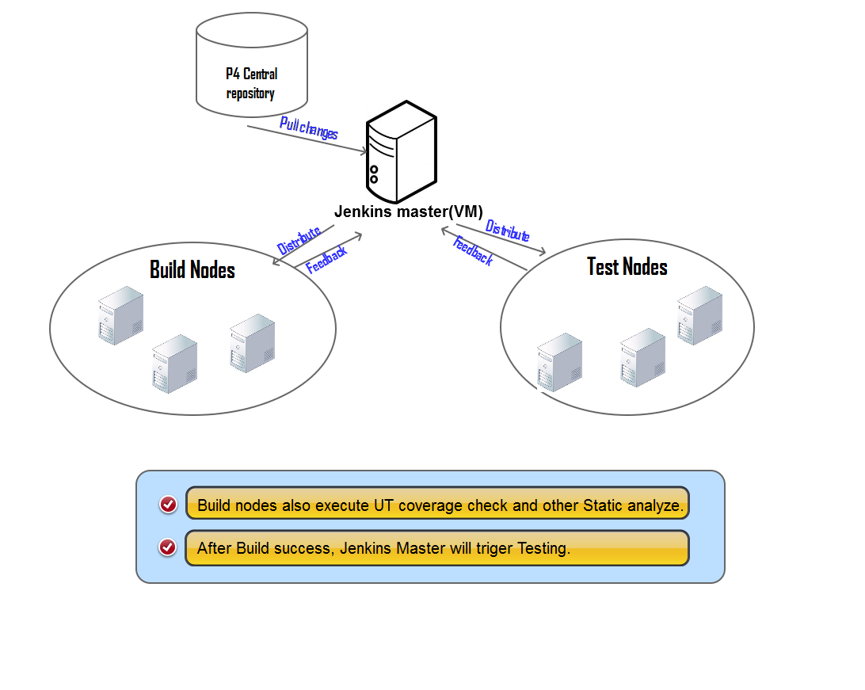
Continues change Integration system

